Slide 1

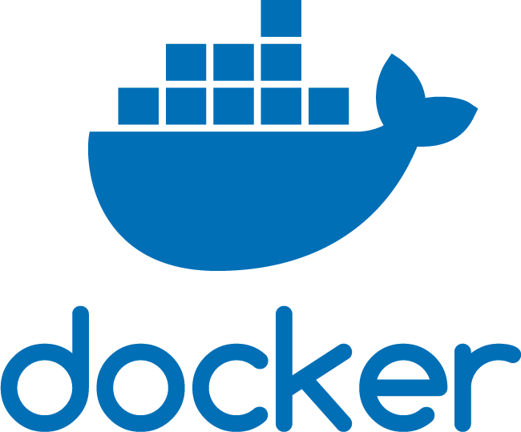
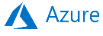




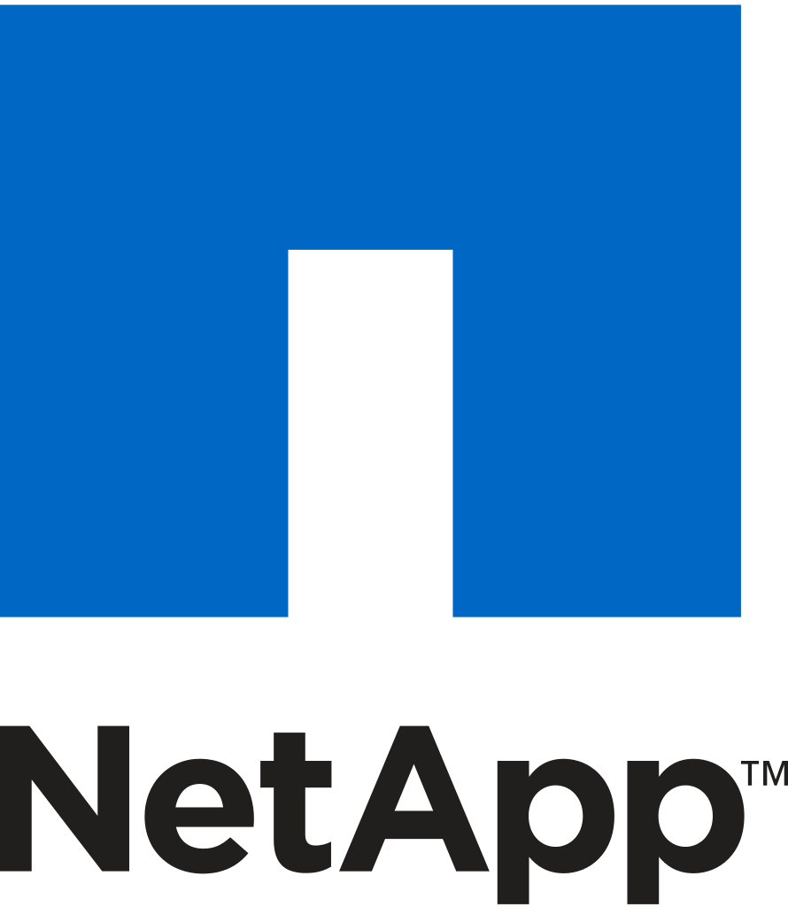
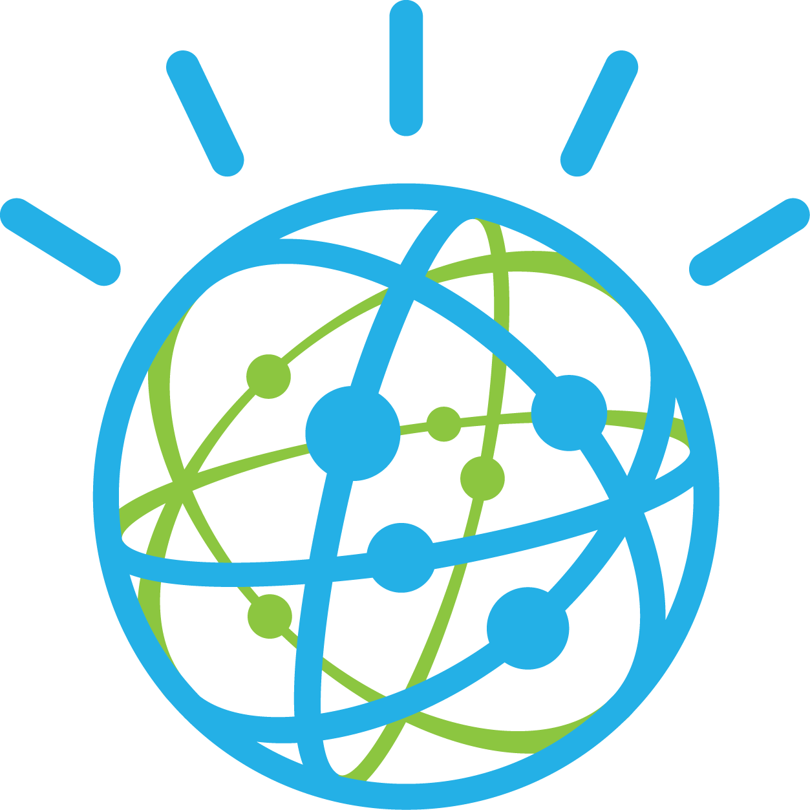


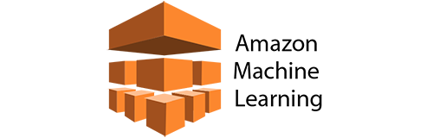
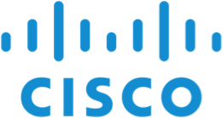
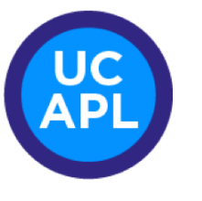

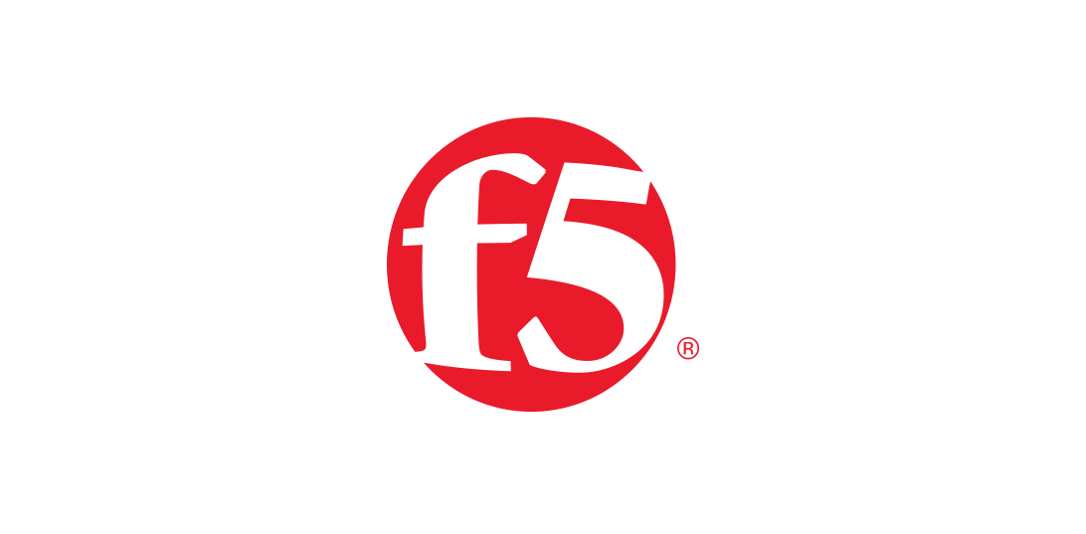

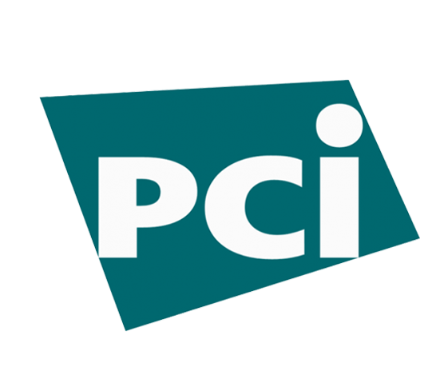


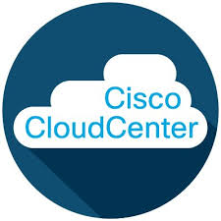
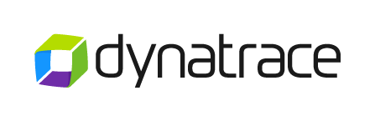

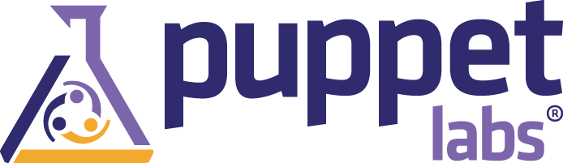
ScienceLogic Providing a Single Pane of Glass for Event Management
PowerSync
Compute
ITSM
See
Contextualize
Act
Storage
AI/ML
Network
Real-time Discovery
PowerMap
Automation
Security/
Compliance
APM
Orchestration

Slide 2




IaC Credentials
Shan to update
Key Benefits
Environment Strategy
and Design
Environment
Provisioning / Migration
Environment Outcomes
Environment Demand Management
Environment Operations and Service recovery
Easily Spin Up Private/Public Cloud Resources.
Quicker Deployment of Bulk resources.
Suitable for Enterprise Grade IaC DevSecOps Tools.
Manual platform Engineering works are automated.
Extensible Automation and capable of full end to end delivery of business application-ready environment.
Environment Delivery timeline minimized to meet Agile needs.
5- 10 Min of time Multiple clusters provisioned instead of waiting 30-45 min for each clusters.
Centralized Infra Management utility.
Opportunity for savings around labor and energy
No Technical Skills required post automation .
Easily Integrated with BMC Remedy.
Environment Build and provisioning
Private and public Cloud automation
Easily Integrated complex deployment of vendor-based products.
workflows to streamline
Push-button deployment
Easily spin up the Azure resources
Small Change request execution
Incident Life cycle Management - Ticket monitoring, Triage, Coordination, analysis and resolution
Environment and DevOps Tools Access management
Platform maintenance.
Accurate and correct Infra configurations and application code
10% increase of Productivity of Environment team
25 – 30% reduction of MTTR
10 – 15% reduction of Environment Turnaround time.
10 % Increase of Change Accuracy.
80-90 % increase of Environment
Availability
2

Slide 3
Cloud Economics Performance Indicators
Cloud Economics
% improvement in time to market
% Reduction in governance effort
Third party spend reduction
Cloud Economics
% Improvement of Developer utilization
Speed to establish project
PERFORMANCE INDICATORS
Inclusive Economics
Governance
% reduction in budget vs actual spend
% reduction through contract negotiation
Budget workflows & intelligent gap analysis
Cloud recommendations across multi cloud
Cost alerts & cost center chargebacks
Cloud provider cost comparisons
Budget usage histogram
Control
Innovative Technology Adherence
Architectural enhancements / landing zones
% Provisioning through Blue prints
% Automation - % Reduced FTEs
% DevOps adoption
Patch / Software currency
% Cloud native ingestion
% of Policy based compliance
Confidence
Intelligent Resource Affluence
% Time usage of non-prod environments
Utilization of resources (on-Demand, RI)
% Right-sized vs. poorly sized
On-Demand vs. Reserved
% of Resources unused / sprawled
Optimize prepaid consumption
Automated house keeping commitment
Establish predictive demand patterns
Convenience
3

Slide 4
Why NewRelic
Item | Azure | NewRelic
Capability Set | Azure Monitor lacks traces for critical infrastructure, service map dependencies are not enabled by default | New Relic is better suited for application/services metrics. (APM) Even though NewRelic has monitoring modules for infra metrics and logs, they lean towards a complete application performance visibility
Ease of Use | Azure Monitor can be complex at searching for metrics and accessing a single pane of glass for complete operational control. Metrics are isolated from each other, and regarding Application metrics, the insight is not the best. It is hard to obtain meaningful data | New Relic is stronger in terms of reporting and exporters. The insights on data are great, specifically for applications and services. there is a single pane of glass to get consolidated data. New Relic counts on its service distribution to trace performance issues and service degradation throughout different IT workflows
Middleware | Azure Monitor does no provide a supported way to monitor middlware layers. | New Relic can trace the whole middleware layer processing, from the service status to deep metrics such as queue size, latency, channel operability and events performance. New relic has native support for commercial event-based technologies such as RabbitMQ, ActiveMQ, and Kafka.
Kubernetes | Azure provides container insights which only extnd its observability to infrastructure metrics such as logs, performance status | New Relic includes Pixie technology for tracing microservices hosted in Kubernetes. Pixie can trace the whole service map distribution to detect anomalies in terms of performance, latency, response code, pod status, and autoscaling. It is extremely useful at detecting issues in Volpay 3x from the Ui layer to the different backend components.
Database | Azure Monitor provides native monitoring for Azure SQL | New Relic noy only provides native integration to Azure SQL, but also it offers complete visibility for multi database technologies, including MongoDB, EC2 MySQL, RDS, Oracle VM-based and Posgres. Having a single pane of glass for DB will increase visibility and speediness to track bottlenecks from the data layer tier.
Endpoints Health Checks | Azure does not provide a native service to monitor the status of endpoints and web services. i.e. Volpay User interface | New relic provides RUM (Real-time user Monitoring), which can health check the endpoint's status, from SSL validation, latency, and response time. New Relic can also trace the UI behavior, by triggering an alert when it detects users' behavior anomalies
SLA/SLO Reports | Azure does not provide a native way to provide a dashboard to customers where they can collect SLO/SLA metrics regarding VolPay Availability | New relic provides pre-configured dashboards and custom metrics for customers based on tags. Each customer could have a general view to retrieve business metrics such as real-time transactions, Service availability, and monthly downtime.
API and Extensibility | Azure Monitor is Azure wide based. The integration for critical third-party services such as Jenkins, Jira, PagerDuty and Terraform is limited. | New Relic has extensive API integration support. It has up to 20 diffeerent notification channels for different targets
Multi-Cloud and Multi-Service | Azure only provides metrics for Azure services. Custom telemetry can be performed, however it comes with a lot of management and maintenance | New Relic has more than 100 integrations available with different services among them the major cloud providers such as GCP, AWS, and Azure. NewRelic also provides native integration with SaaS and PaaS services highly used by Volante such as MongoDB,Cassandra and Redis
Open telemetry Open Metrics | Most of the app instrumentation for open metrics isn't well-documented. The instrumentation in many cases is hard to achieve, and no automated way is out of beta right now | New relic has open telemetry and open metrics support by adding native integration with Prometheus. The instrumentation for the different code languages is well-documented
Success Stories |  | Runkeeper, Tableau, Nike, Gawker Media, ESPN, and Sony
Learning Curve |  | Both platforms have been designed to be very interactive, along with the documentation, both platforms provide extensive training material including videos, courses, step by step post, and best practices architectures
AI and Proctive Metrics | Azure provides a very basic alert triggering system. Most of thresholds and alerts need to be setup up manually | New Relic provides an extensive list of pre-configured alert methods. From infrastructure metrics, log aggregation, service's status, middleware processing, UX experience, Realtime processing, etc.
Security Rating |  | New relic encrypts all data in transit as well at rest. No critical data is sent to New relic PoP. New relic only uses metadata to collect metrics and services status. From Volante's approach, we won't use NewRelic to store logs.

Slide 5
